Slide 1
SAP HANA
Lesson Name: Introduction to SAP HANA
Notes:
Add instructor notes here.

Slide 2
Contents
Introduction to SAP HANA
Evolution of ABAP For SAP HANA
HANA Architecture
SAP In-Memory
SAP HANA Database Concepts
Row Store
Column Store
Database Compression
Code Pushdown
Data Provisioning

Slide 3
Lesson Objectives
After completing this lesson, participants will be able to -
Know about SAP HANA
Understand HANA Architecture
Understand SAP In-Memory Concept
Understand HANA Database Concepts
Know about Database tables -
Row Store
Column Store
Understand Data Provisioning
Notes:
Add instructor notes here.

Slide 4
Introduction to SAP HANA
SAP stands for System, Application, Product in Data Processing.
HANA stands for High-performance Analytic Appliance.
SAP HANA appliance is a hardware and software combination that integrates a number of SAP components
SAP HANA is a flexible, data-source-agnostic appliance that enables customers to analyze large volumes of SAP-ERP data in real-time.
Notes:
Add instructor notes here.

Slide 5
Introduction to SAP HANA
SAP HANA Database is a hybrid in-memory database.
SAP HANA combines row-based, column-based, and object-based database technology
SAP HANA database consists of multiple servers
SAP HANA database is developed in C++ and runs on SUSE Linux Enterprise Server
Notes:
Add instructor notes here.

Slide 6
Introduction to SAP HANA
HANA is a Break-through Technology:
The application developed so far will acknowledge the fact that this typically requires making several trade-off decisions.
Trade Off is a situation that involves losing one quality or aspect of something in return for gaining another quality or aspect. If one thing increases, some other thing must decrease
The graphics on the next slide show the five dimensions of requirement that are typically required for a business applications.
With a traditional database, addressing these all 5 dimensions have been conflicting so far and challenged developers very badly.
Development of an application which is both real-time and able to analyze a large amount of data at the same time is not possible.
Notes:
Add instructor notes here.

Slide 7
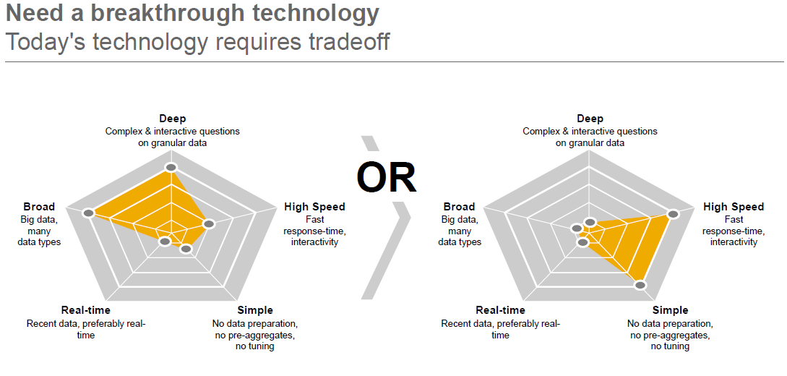
Introduction to SAP HANA Traditional System involved losing one quality or aspect. something in return for gaining another quality or aspect
Before HANA, developing applications required several trade of decisions. Picture above, shows five typical dimensions while building a business applications.
As an example, we may have to decide between providing a high-speed application and developing an application which does not required special preparation of processing data e.g. calculating aggregations beforehand and sorting the result set. Also it was very difficult to develop an application which is both real-time and able to analyze a large amount of data.
Notes:
Add instructor notes here.

Slide 8
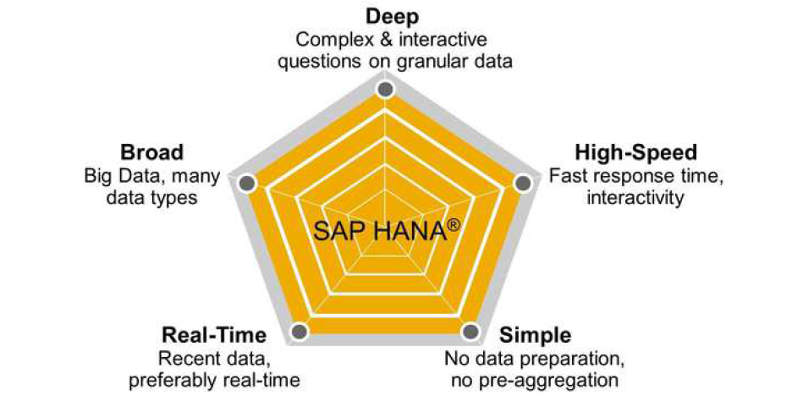
Introduction to SAP HANA HANA delivers all the five dimensions, so that you no longer have to make any trade-off decisions
.
The goal is to enable the development of applications that combine Online
Transaction Processing (OLTP) and Online Analytical Processing (OLAP) usage patterns.

Slide 9
Evolution of ABAP for SAP HANA
With support package stack (SPS) 05 for SAP NetWeaver 7.4, SAP has brought ABAP and SAP HANA together with features that enable developers to leverage the best of both worlds.
ABAP lays the foundation for countless SAP applications, with a broad range of features and functionality for creating powerful business solutions.
SAP HANA provides the opportunity to innovate with new and sophisticated technologies.
Notes:
Add instructor notes here.

Slide 10
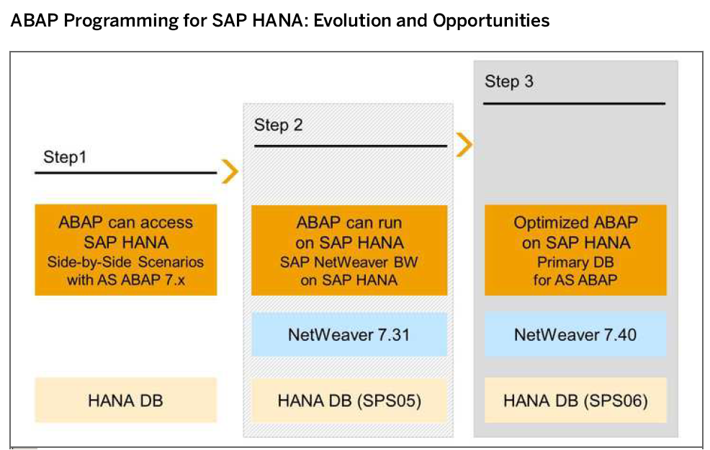
Evolution of ABAP for SAP HANA
Notes:
Add instructor notes here.

Slide 11
SAP In-Memory
SAP HANA is an in-memory database:
An in-memory database means all the data is stored in the memory (RAM).
Data now resides in main-memory (RAM) also.
It’s best suited for performing real-time analytics, and developing and deploying real-time applications.
The speed advantages offered by this RAM storage system are further accelerated by the use of multi-core CPUs, and multiple CPUs per board, and multiple boards per server appliance.
Notes:
Add the notes here.
Add instructor notes here.

Slide 12
Code Pushdown:
In HANA, you can push down data intense computations and calculations to the HANA DB layer instead of bringing all the data to the ABAP layer and then processing the data to do computations.
This is what is termed as Code-to-Data paradigm in the context of developing ABAP applications optimized for HANA.
It is basically a programming style in ABAP where you code to ‘push down’ data intensive computations to the HANA DB layer.
It is one of the key differences for developing applications in ABAP for HANA.

Slide 13
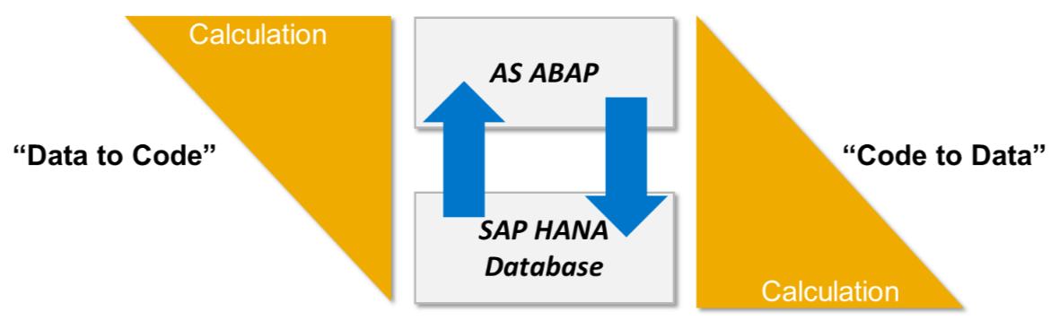
Code Pushdown:

Slide 14
Review Question
SAP HANA Studio provides an environment for Administration, Modeling and Data Provisioning. (True/False)
SAP HANA is a ___________ database.
Real time replication supported by ___________.
For small and extensive write operations,________ store is advisable.
SLT uses _____ technology to transfer data.
Notes:
Add the notes here.
Add instructor notes here.

Slide 15
Review Question
The SAP HANA database is developed in ______ and runs on ______ Server.
SAP HANA database consists of ______ Server, _____ Server, ______ Server, _________ Server and _______ Engine.
SAP HANA database cannot store more than _______rows for a non-partitioned table.
Notes:
Add the notes here.
Add instructor notes here.

